Slide 1


Doña Ana County Treasurer
Investment Report
Prepared by Eric L. Rodriguez
County Treasurer
August 25, 2023
End of Period
FY 2023

Slide 2
Primary Objectives
Safety: Investments shall be undertaken in a manner that seeks to ensure the preservation of capital in the overall portfolio. The objective will be to mitigate credit risk and interest rate risk.
Liquidity: The investment portfolio shall remain sufficiently liquid to meet all operating requirements that may be reasonably anticipated.
Return: The investment portfolio shall be designed with the objective of attaining a market rate of return throughout budgetary and economic cycles.

Slide 5
Holdings

Slide 6
Maturity Distribution

Slide 7
Weighted Average Maturity
Weighted Average Maturity
As of 06/30/2023
Investment Type | FMV | Weighted Average Maturity | Fair Value*
CDs | 28,163,284.31 | 1.81 | 2
CDARS | 2,032,303.31 | 0.53 | 2
Money Market, Savings, & and Checking | 39,411,063.26 | 0.00 | 2
US Treasury Notes and Bonds | 2,931,697.39 | 2.19 | 1
Revenue Bond | 4,010,000.00 | 10.47 | 2
Municipal Bonds | 3,604,674.31 | 4.06 | 2
Tenn Valley Auth | 397,427.50 | 2.90 | 1
Federal Farm Credit | 40,908,369.29 | 2.42 | 1
Federal Home Loan Bank | 55,730,104.14 | 1.94 | 1
Fannie Mae | 3,951,362.88 | 1.64 | 1
Freddie Mac | 13,085,029.94 | 1.94 | 1
Farmer Mac | 1,915,300.00 | 0.85 | 1
 | 196,140,616.32 | 2.56
*Fair Market Measurements Using:
Quoted Prices in Active Markets for Identical Assets (Level 1)
Significant Other Observable Inputs (Level 2)
Estimated Value Ranges (Level 3)

Slide 8
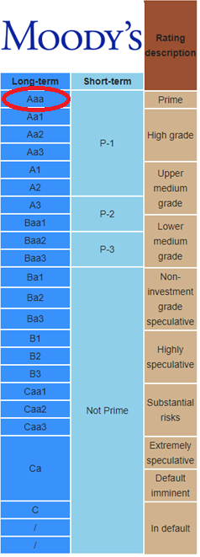
Credit Quality

Slide 9
Total Earnings Trend

Slide 10
5 Year Monthly Earnings Comparison

Slide 11
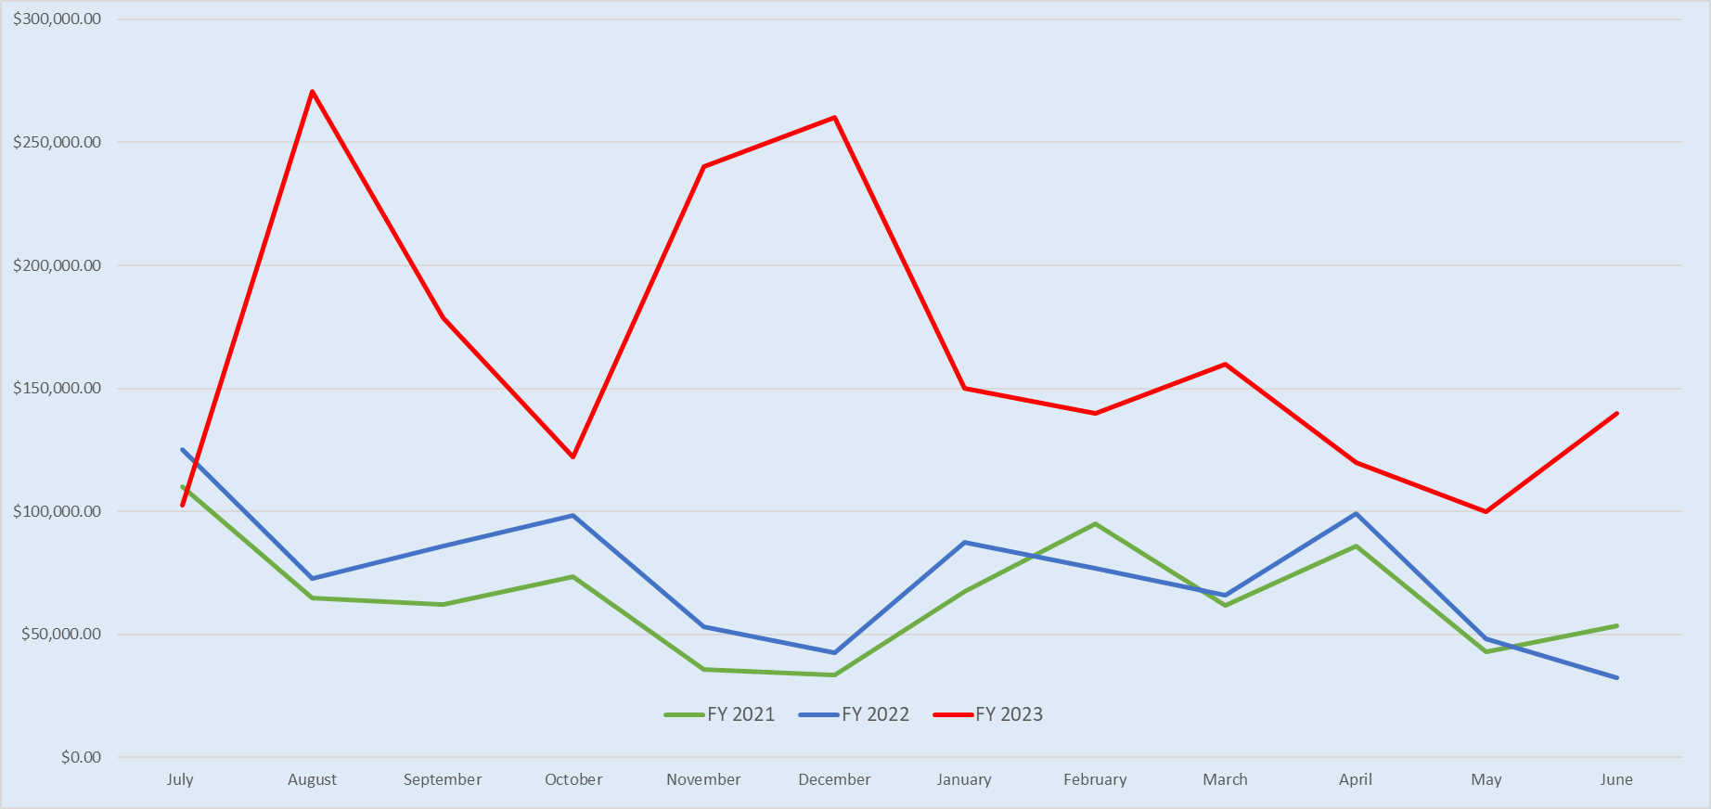
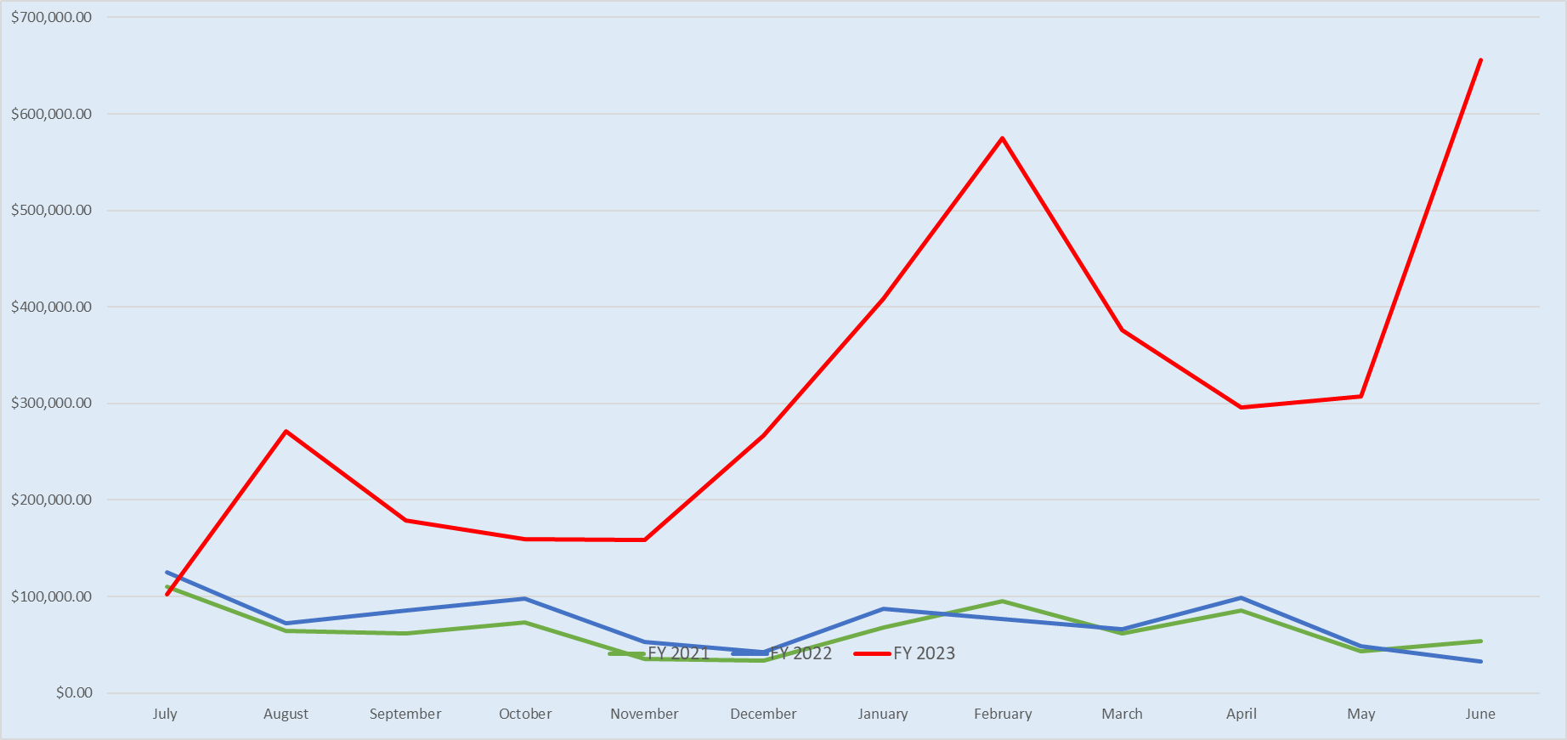
Forecasted vs Actual Earnings Trend
Forecasted Revenues
Actual Receipted

Slide 12
Investment Policy Compliance

Slide 13
Moving Forward
Strategy
  Continue to take advantage of recent rate increases. Focus on laddered portfolio.
  Manage and forecast cash flows to maximize on long term holdings
  Secure low call risk or bullet holdings
  Increase Brokered CD holdings which carry minimal risk and good spreads
Economic Factors to Consider
  Interest rate hikes may continue:
  “The Fed is “prepared” to raise interest rates further “if appropriate…the war on inflation has a long way to go even with the more favorable recent readings” – Jerome Powell, 08-24-2023
  Recent government data (CPI) shows inflation at 3% in June up to 3.2% July
  Job openings in the U.S. fell in July to a 28-month low of 8.8 million, as companies scale back hiring in response worries about an economic slowdown. More job data to come, unemployment expected to stay at 3.5% this week.
  Recession probability forecasts = Depends on who you ask. Goldman Sachs predict 20% chance. Most agree it will be “swift and soft”

